Slide 1
Data Privacy · Assignment 2 seminar
On the Privacy Risks of Model Explanations
Reza Shokri, Martin Strobel and Yair Zick · AIES 2021
Michail Pettas · 2 October 2026
Notes:
Hi, I'm presenting Shokri, Strobel and Zick, "On the privacy risks of model explanations", from AIES 2021. The short version: explanations are supposed to make ML more transparent, but they are computed from a model trained on private data, so they can leak that data. I'll go through the attack, the results, what I think is weak about the evidence, and how it connects to the unlearning paper by Bertran et al.

Slide 2
Every explanation is computed from a model that was trained on personal data.
There is a debate about a “right to explanation” in the GDPR (Art. 13–15, 22), and Google, Microsoft and IBM already ship explanation toolkits.
Notes:
Why does this matter? Models are used for credit, health care, hiring, and people want to be able to contest the decisions. That has led to the debate around a right to explanation in the GDPR, and the big cloud providers all ship explanation tools now. So this is not only a research thing. But an explanation is just more information released about a model trained on personal data, and anything you release can leak. Before this paper nobody had really measured how much.

Slide 3
Research question
Can an adversary use model explanations to infer private information about the training data, and which kinds of explanations make this possible?
Measured with membership inference: was this record part of the training set?
Notes:
This is the research question. They measure the leakage with membership inference, which is the standard way to audit what a model leaks. Membership alone can already be sensitive, for example if the model is trained only on patients with a certain disease. The UK ICO also lists membership inference as a threat in its AI auditing guidance.

Slide 4
Three types of explanations
Backpropagation-based: the gradient (saliency map) and variants like Integrated Gradients, Guided Backprop and LRP
Perturbation-based: query the model on noisy copies of the input, e.g. SmoothGrad and LIME
Example-based: return the training points that influenced the prediction most (influence functions, Koh & Liang 2017)
The main paper covers the first two. Example-based explanations are in the appendix.
Notes:
There are three families. Backpropagation-based ones like the plain gradient, where each feature gets a score for how much it influences the prediction. Perturbation-based ones like SmoothGrad and LIME, which query the model on noisy copies of the input. And example-based ones, which return actual training points instead of feature scores. The main paper is about the first two, and the example-based part is in the appendix, but honestly I think the appendix has the most striking results.

Slide 5

Threat model
Attacker holds a candidate record x
Model API, trained on private data
Half the candidates are members, so guessing gives 50%
The attacker knows the architecture and training setup
Threshold: optimal (worst case) or from shadow models (realistic)
Returns prediction c(x) and explanation φ(x)
Attacker guesses: member or not?
Notes:
The threat model is simple. The attacker has some records and wants to know which ones were in the training set. They send a record to the model and get back the prediction and the explanation. The candidate set is half members, so 50% is the baseline to beat. They assume the attacker knows the architecture, following Kerckhoffs's principle, and for choosing the threshold there are two versions: the optimal threshold, which you can only compute if you already know membership, so it's a worst-case estimate, and the realistic one where you train one or three shadow models on similar data.

Slide 6
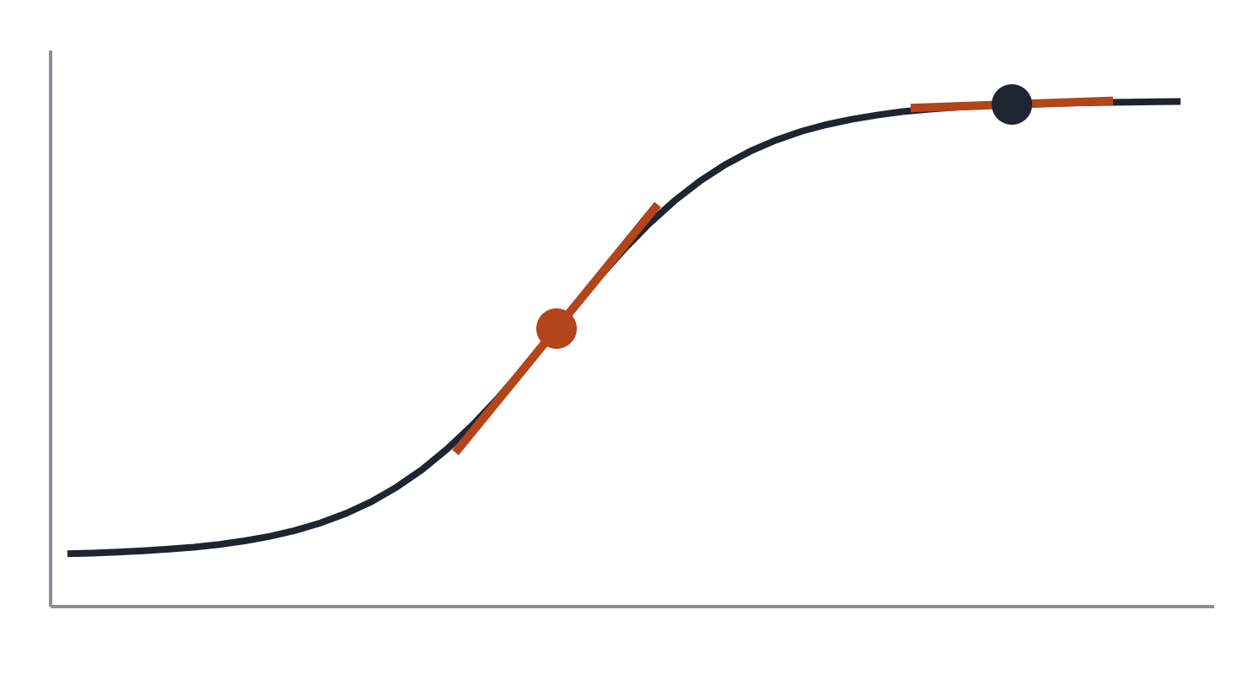
The attack: threshold the variance of the explanation
member(x) ⇔ Var(φ(x)) ≤ τ
model output
unseen point: steep, large gradient
training point: flat, small gradient
Training pushes the boundary away from training points
So members sit where the output is flat
No label needed: high variance ≈ high loss
distance from boundary →
Notes:
The attack itself is very simple. You compute the variance of the explanation vector and call the point a member if it's below a threshold. The intuition is in the picture: training pushes the decision boundary away from training points, so around a member the output is flat and saturated, and changing a feature barely changes anything. Small gradient, low variance. Points near the boundary, where tanh or softmax is steep, get big gradients, and those are more often non-members. So high variance is basically a stand-in for high loss, but you don't need the true label. They also use the prediction variance the same way, and they note the L1 norm works just as well as the variance.

Slide 7
Experimental setup
Dataset | Features | Classes | Train acc. | Test acc.
Purchase (shopping) | 600 | 100 | 1.00 | 0.75
Texas (hospital stays) | 6,170 | 100 | 0.98 | 0.52
CIFAR-100 | 3,072 | 100 | 0.97 | 0.29
CIFAR-10 | 3,072 | 10 | 0.93 | 0.53
Diabetic Hospital | 127 | 2 | 0.64 | 0.61
UCI Adult (census) | 104 | 2 | 0.85 | 0.85
Tanh MLPs for the tabular data, a CNN and AlexNet for CIFAR. 100 attacks per dataset.
Notes:
They use six datasets. Purchase and Texas are high-dimensional binary tabular data, then CIFAR-10 and 100, and two low-dimensional ones, Hospital and Adult. The column I want you to look at is the gap between training and test accuracy. Texas is 98 versus 52, CIFAR-100 is 97 versus 29. So most of these models overfit a lot, which matters later when we talk about how realistic the numbers are. Each dataset is split into four parts so each model can be a shadow model for the others, and it's repeated 25 times.

Slide 8
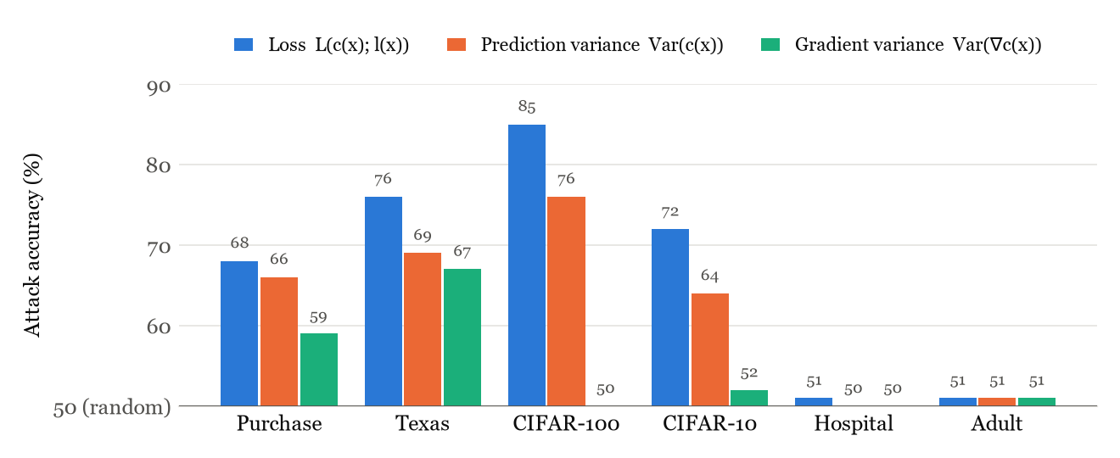
Results: backpropagation-based explanations
Re-plotted from Fig. 1 of the paper (optimal threshold); values read from the published chart. Bars start at 50%.
Notes:
This is the main result. Gradient variance gives 59% on Purchase and 67% on Texas, against 50% for guessing. The authors call it a clear proof of concept. On the image datasets it's basically random, because gradient variance jumps around a lot between images. On Adult and Hospital nothing works, not even the loss attack, and those are the models that don't overfit. Two more things: shadow models get close to the optimal threshold, especially with three, so a real attacker can do this. And the prediction variance is almost as good as the loss, so you don't need the label. But notice the green bar is never higher than the blue one: the explanation never leaks more than the loss.

Slide 9
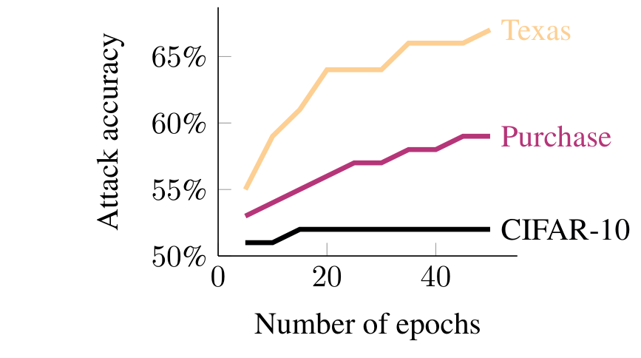
Why does it leak?
On synthetic data there is no signal below about 100 features. That is why Adult (104) and Hospital (127) fail.
The more the model overfits, the better the attack works (right).
Right: Fig. 5 from Shokri et al. (2021).
Notes:
Why does it work on some datasets and not others? They test this with synthetic data. With few features, members and non-members are equally close to the boundary, so there's no signal, which is what we saw on Adult and Hospital. Between about a thousand and ten thousand features there is a clear correlation. The plot is their Figure 5: if you train longer, the attack on Texas goes from 55 to 67 percent, Purchase from 53 to 59, and CIFAR-10 stays flat. So the leakage comes from the model overfitting, and the explanation just exposes it.

Slide 10
SmoothGrad and LIME
≈ 50%
The authors’ guess: they query points off the data manifold, which say nothing about the training set
But that also makes them less faithful and easier to fool (Slack et al. 2020)
Odd: the gradient attack hit 84% on Texas in the small LIME setup
attack accuracy in every setting tested
Notes:
SmoothGrad and LIME don't leak at all in their experiments. Their explanation is that these methods evaluate the model on noisy points that are off the data manifold, where the model's behaviour is basically unspecified and says nothing about the training data. But they point out that this is also why these explanations are criticised: they are less faithful, and Slack et al. showed you can fool LIME. So the privacy might just come from being a worse explanation. One strange thing: the LIME experiment was smaller because LIME is slow, and in that setup the plain gradient attack suddenly got 84% on Texas, which they can't explain.

Slide 11
Example-based explanations give the training data away
63%
99.4%
4.6%
of Hospital training points appear in their own top-5 explanation
of Dog/Fish training images reconstructed
of Adult, limited by the number of features
Logistic regression and last-layer models, about 2,000 training points.
Notes:
Now the appendix, which I think is the scariest part. With example-based explanations you don't need statistics: if a training point shows up in its own explanation, it's definitely a member. For Hospital that's 63% of the training set with top-5 explanations. Then they go further and reconstruct the dataset. Their algorithm keeps querying in the region where the points it already found have zero influence, so a new point has to come up. On Dog/Fish they get back 1,790 of 1,800 images. On Adult and Hospital much less, because the algorithm can't recover more points than the number of features. Note this is only logistic regression on small datasets.

Slide 12
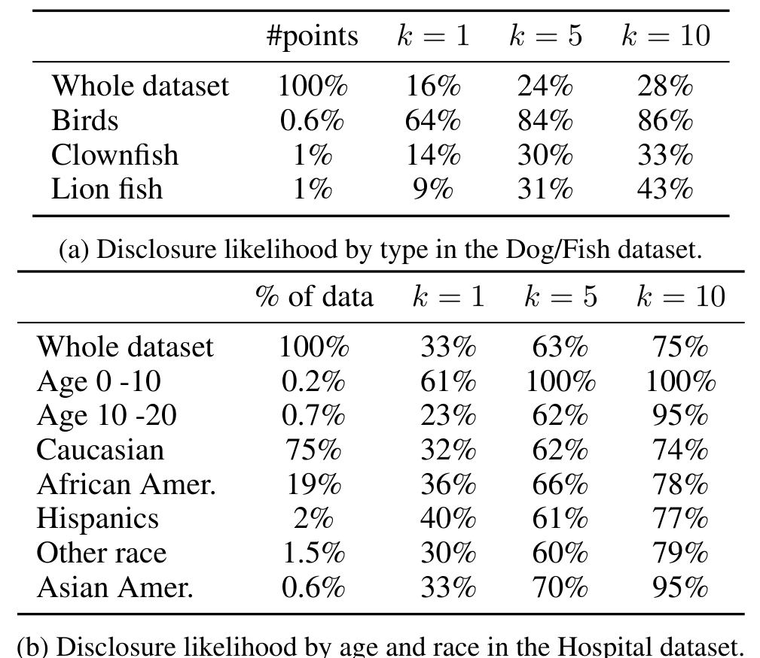
Small groups are revealed far more often
Birds are 0.6% of the Dog/Fish images, and 84% of them are revealed at k = 5 (24% overall).
Every child aged 0–10 in the Hospital data is revealed at k = 5.
But 0.2% of 2,000 points is about four people.
Right: Table 3 (a, b) from Shokri et al. (2021).
Notes:
This was the result I found most worrying. This is Table 3 from the paper. Small groups get revealed much more often. Birds in the Dog/Fish data are 0.6% of the images and 84% of them are revealed at k equals 5, compared to 24% overall. Children under 10 in the Hospital data are all revealed. The reason is that unusual points are more influential and more memorised, and transparency is partly supposed to protect exactly these groups. Adult is an exception, young and Black people are revealed less there because those attributes predict the label well. And the caveat: these groups are tiny, 0.2% of 2,000 points is four people.

Slide 13
My assessment
Good
Weak
Started the research on explanation privacy
Broad: 6 datasets, 7 methods, plus theory
Explains when leakage happens
Simple attack, no labels needed
Only average accuracy, no TPR at low FPR (Carlini et al. 2022)
Never beats the loss attack
Overfitted targets, no DP model
Off-manifold claim untested, no error bars
Notes:
My assessment. Good things: it started the whole topic, it's broad, and I like that they try to explain when leakage happens instead of only reporting numbers. The weak points. First, they only report average accuracy. Carlini et al. later showed that this can hide whether you can identify anyone with confidence, so 67% could be a few people identified for sure or a weak signal on everyone. Second, the explanation never does better than the loss, so it's mostly a proxy for the loss; the extra risk is only for services that hide confidence scores but show explanations. Third, the models overfit heavily and there's no DP or regularised model. And the off-manifold explanation for SmoothGrad is never tested, for example by changing the noise level.

Slide 14
Differential privacy covers some explanations for free
Feature-based
Example-based
Gradient, Integrated Gradients, LRP, SmoothGrad and LIME only use the trained model and the query.
Influence-based explanations read the training data again every time an explanation is computed.
Train with DP (e.g. DP-SGD) and the explanations inherit the guarantee by post-processing, at no extra cost.
Post-processing does not apply: they need their own mechanism (Patel, Shokri and Zick 2022).
Notes:
Connecting this to the course. Neither paper actually tests a defence, but we can reason about DP. A gradient explanation only depends on the trained model and the query point. So if the model is trained with DP, say DP-SGD, the post-processing property means all feature-based explanations are DP too, for free. Example-based explanations are different: they look at the training data again when you ask for an explanation, so post-processing doesn't cover them. I think that's the simplest way to see why they did so much worse in the paper. Later work by the same group builds DP explanations.

Slide 15
The same maths as the unlearning attack in Bertran et al.
Shokri et al. 2021
Bertran et al. 2024
Right to explanation
Right to erasure
Influence-function explanations are built on H⁻¹∇ℓ, the effect of one training point on the model.
Hessian × (model before − model after) ≈ gradient of the deleted record, which gives the record back.
In both, something added for a GDPR right leaks more than the model alone.
Notes:
The paper I'm asking questions about, Bertran et al., attacks machine unlearning. When someone asks to be deleted, you can compare the model before and after, multiply by an estimated Hessian, and get back roughly the gradient of the deleted record, and from that the record itself. That's the same influence-function maths that the Koh and Liang explanations use. So both papers make the same point: something we add to serve a GDPR right, explanation or erasure, releases a second view of the model that leaks more than the model alone. And in both, membership inference on the simple models is basically random, but reconstruction works.

Slide 16
Future work
Explanation methods with differential privacy, and a measure of how much worse they get
Re-run the attacks with TPR at low FPR, on DP-trained and less overfitted models
Explanations and unlearning from the same service: do the leaks add up?
Minority exposure with larger groups
My takeaway: explanations are part of what a model reveals about its training data, just like predictions and confidence scores.
Notes:
To wrap up, what I think should come next: explanation methods with formal DP guarantees where someone actually measures how much worse the explanations get; re-running these attacks with better metrics and on models that don't overfit so much; and, connecting to Bertran, what happens when one service offers both explanations and unlearning. My main takeaway is that an explanation should be treated as part of what a model reveals about its training data, just like predictions and confidence scores.

Slide 17
Questions?
R. Shokri, M. Strobel, Y. Zick. On the privacy risks of model explanations. AIES 2021.
Michail Pettas · mipe5495@umu.se
Notes:
Thanks, happy to take questions. Likely ones: is 59 to 67 percent a real risk (moderate on average; the real question is whether specific people can be identified with few false positives, which they don't measure); why not just hide confidence scores (the gradient carries almost the same signal); should we stop explaining (the authors say no, we need explanations with a measured privacy and quality trade-off).

